Slide 1
Data Analytics – Lesson 19 Advanced Cluster Models
Jeffrey Strickland, Ph.D., CMSP, ASEP
CEO Humalytica Analytics

Slide 2
Vegan Package Clustering
The functions in the vegan package contain tools for diversity analysis, ordination methods and tools for the analysis of dissimilarities. Together with the labdsv package, the vegan package provides most standard tools of descriptive community analysis.
The dune meadow vegetation data, dune, has cover class values of 30 species on 20 sites. The corresponding environmental data frame dune.env has following entries:
A1: a numeric vector of thickness of soil A1 horizon.
Moisture: an ordered factor with levels: 1 < 2 < 4 < 5.
Management: a factor with levels: BF (Biological farming), HF (Hobby farming), NM (Nature Conservation Management), and SF (Standard Farming).
Use: an ordered factor of land-use with levels: Hayfield < Haypastu < Pasture.
Manure: an ordered factor with levels: 0 < 1 < 2 < 3 < 4.

Slide 3
H-Clustering
Hierarchical cluster analysis on a set of dissimilarities and methods for analyzing it.
Level 1
Level 2A
Level 2B
Level 2C
Level 3A1
Level 3A2
Level 3B1
Level 3C1
Level 3B2
Level 4C1
Level 4C2

Slide 4
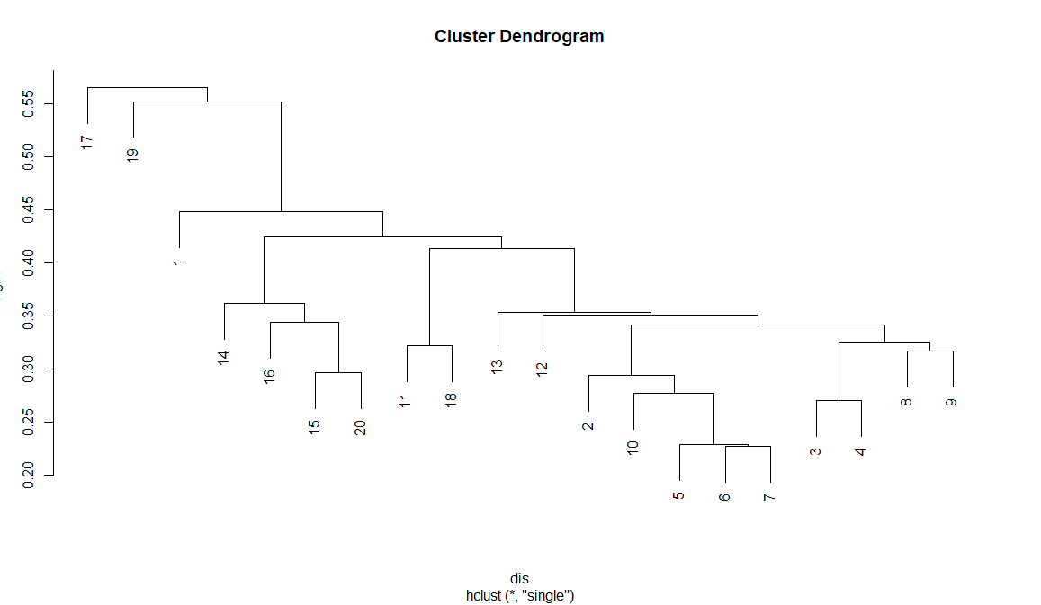
H-Cluster: Single
Distance between groups is defined as the distance between the closest pair of objects, one from each group.

Slide 5
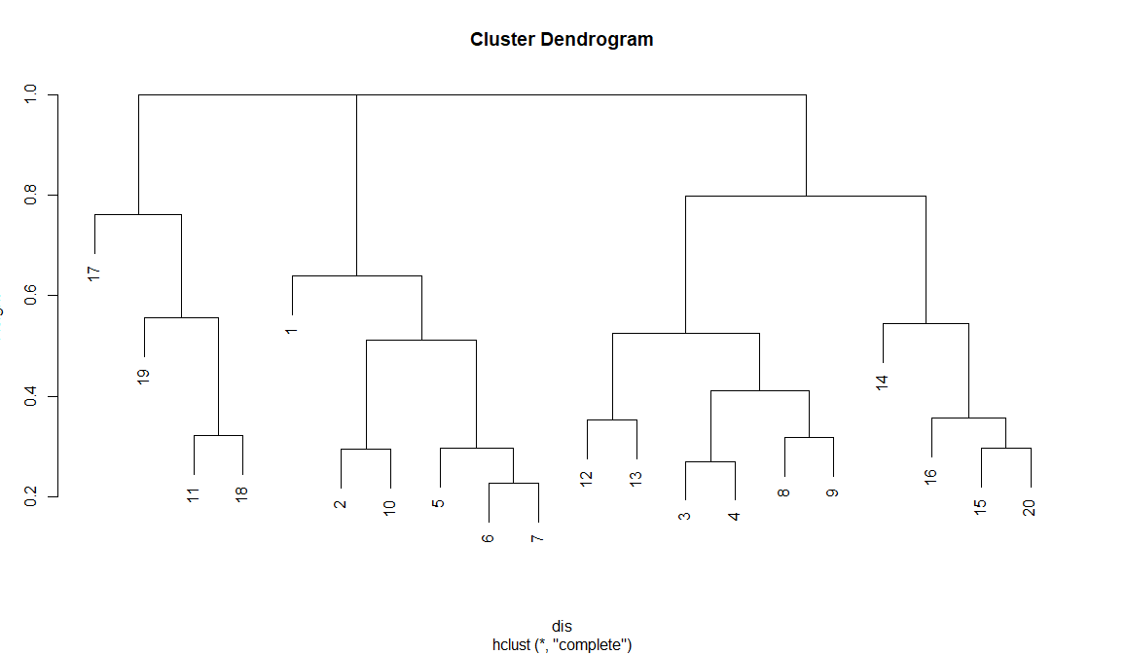
H-Cluster: Complete
Distance between two clusters is defined as the average of distances between all pairs of objects, where each pair is made up of one object from each group.

Slide 6
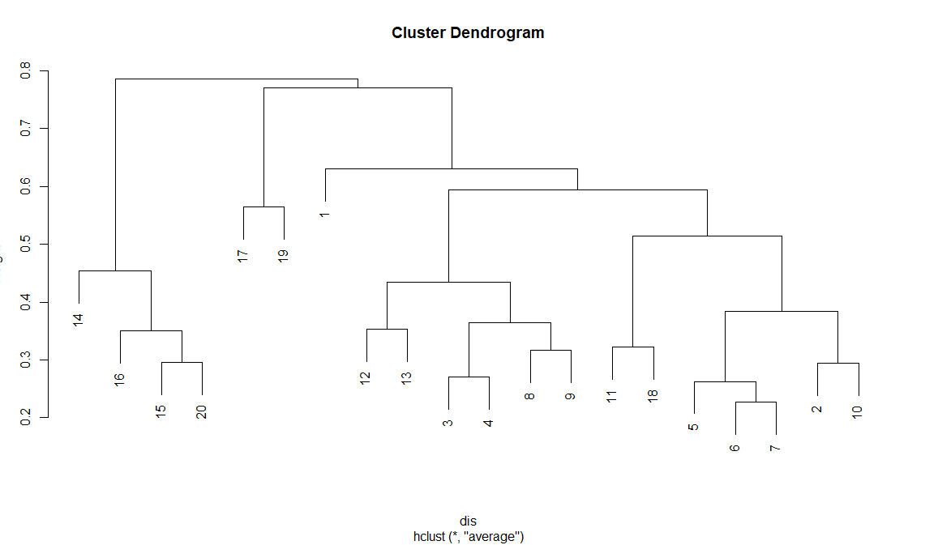
H-Cluster: Average
Distance between groups is defined as the distance between the most distant pair of objects, one from each group. Complete linkage is also called farthest neighbor.

Slide 7
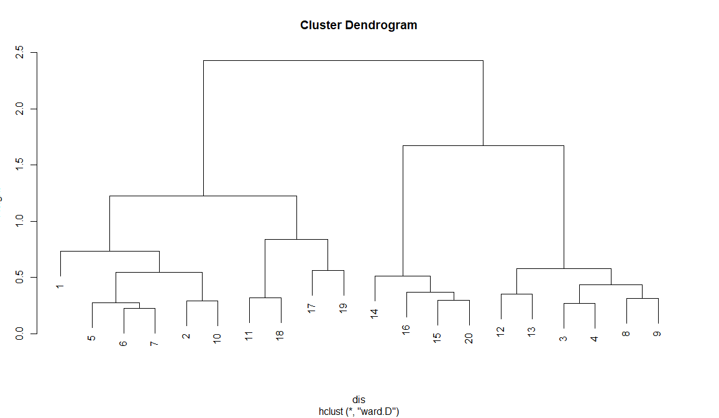
H-Cluster: Ward
Ward’s distance

Slide 8
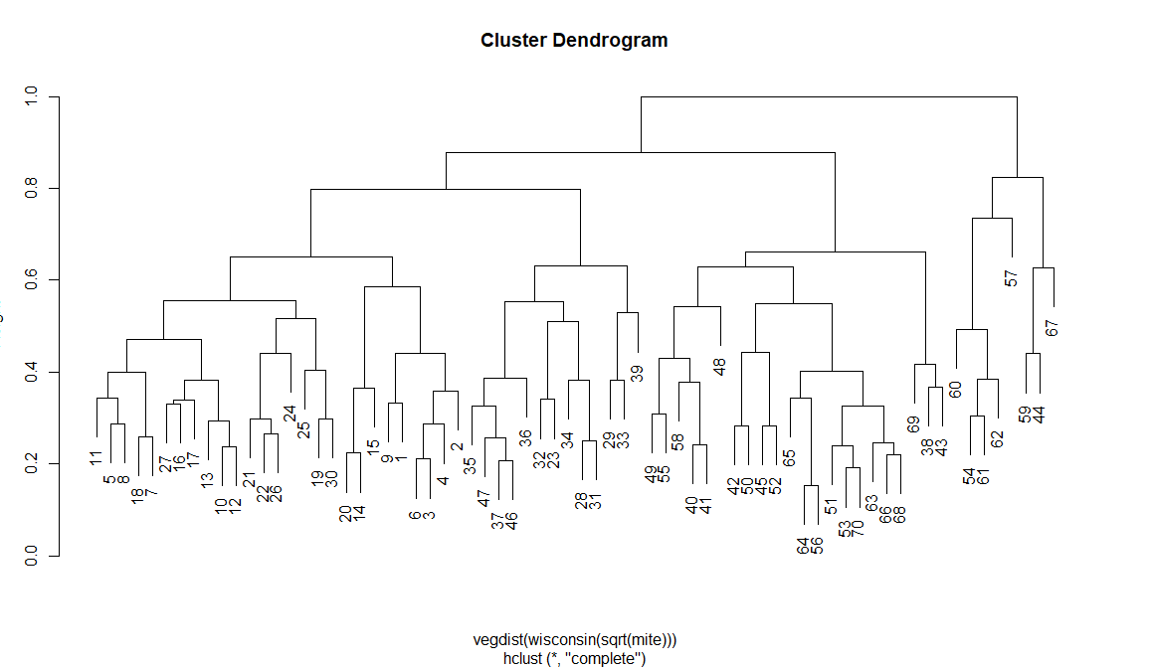
Reorder a Hierarchical Clustering Tree
Reordered hclust result object with added item value that gives the value of the statistic at each merge level.
## reorder by water content of soil
data(mite, mite.env)
hc <- hclust(vegdist(wisconsin(sqrt(mite))))
ohc <- with(mite.env, reorder(hc, WatrCont))
plot(hc)
plot(ohc)

Slide 9
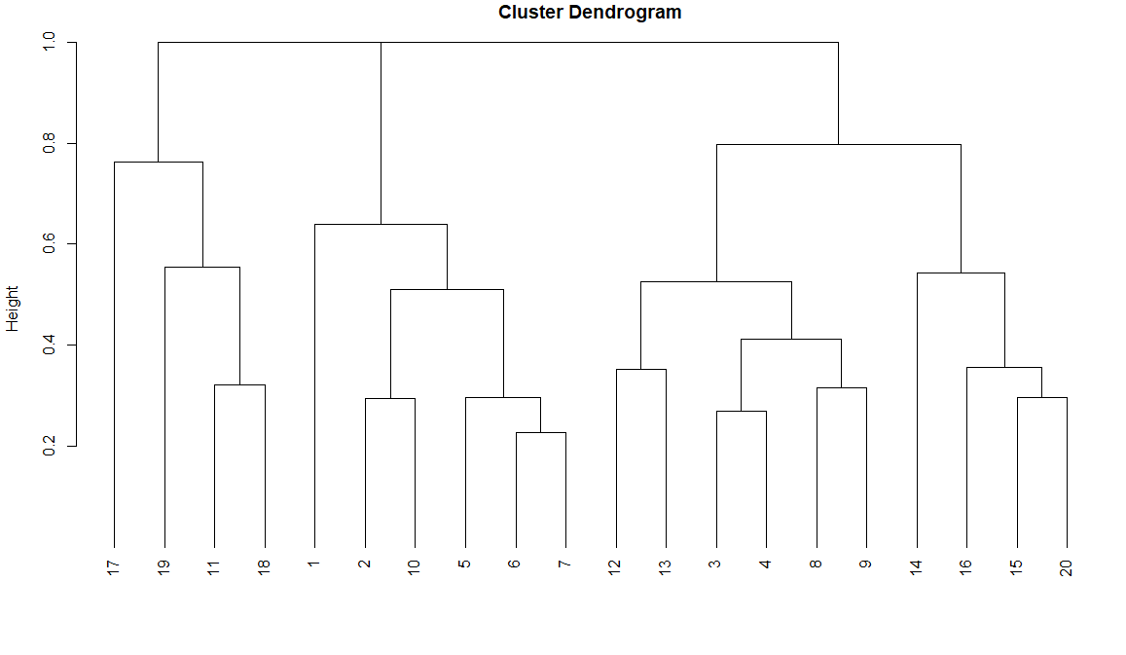
Dune data H-Cluster: Complete
d <- vegdist(dune)
par(mfrow=c(1,3))
par(mfrow=c(3,1))
par(mfrow=c(1,1))
par(mar=c(3,4,1,1)+.1)
ccom <- hclust(d, method=“complete")
ccom
Call: hclust(d = d, method = "complete")
Cluster method : complete
Distance : bray
Number of objects: 20

Slide 10
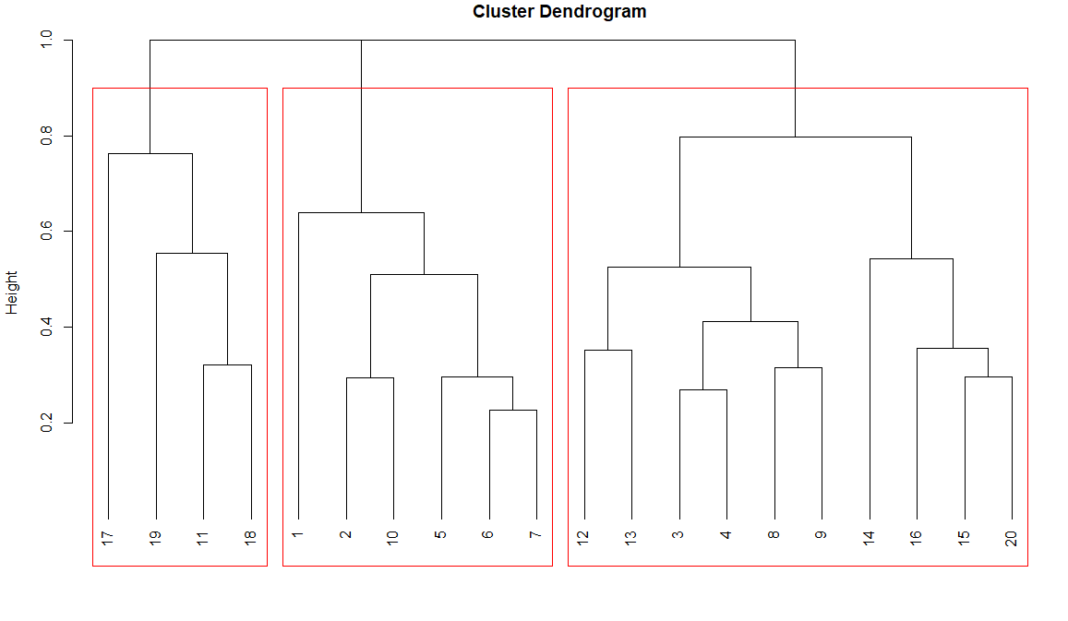
Pruning a H-Cluster tree
cl <- cutree(ccom, 3)
cl
table(cl)
cl
1 2 3
6 10 4

Slide 11
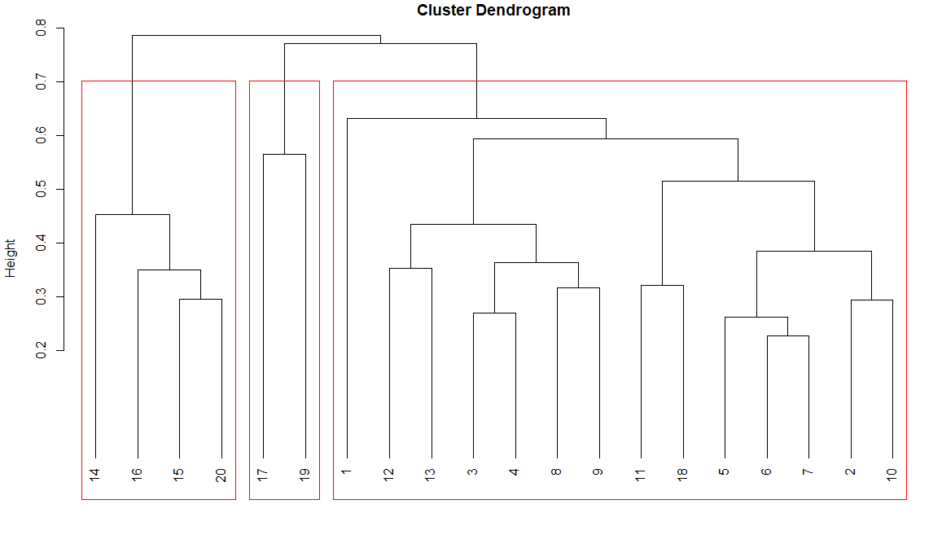
Dune data H-Cluster: Cut (Pruned)
vegemite(dune, caver)
plot(csin, hang=-1)
rect.hclust(csin, 3)
plot(ccom, hang=-1)
rect.hclust(ccom, 3)
plot(caver, hang=-1)
rect.hclust(caver, 3)
cl <- cutree(ccom, 3)
# Cuts a tree into several groups either by specifying the desired number(s) of groups or the cut height(s)
cl
Note: Hang is the fraction of the plot height by which labels should hang below the rest of the plot. A negative value will cause the labels to hang down from 0.
1 2 3 4 5 6 7 8 9 10 11 12 13 14 15 16 17 18 19 20
1 1 1 1 1 1 1 1 1 1 1 1 1 3 3 3 2 1 2 3

Slide 12
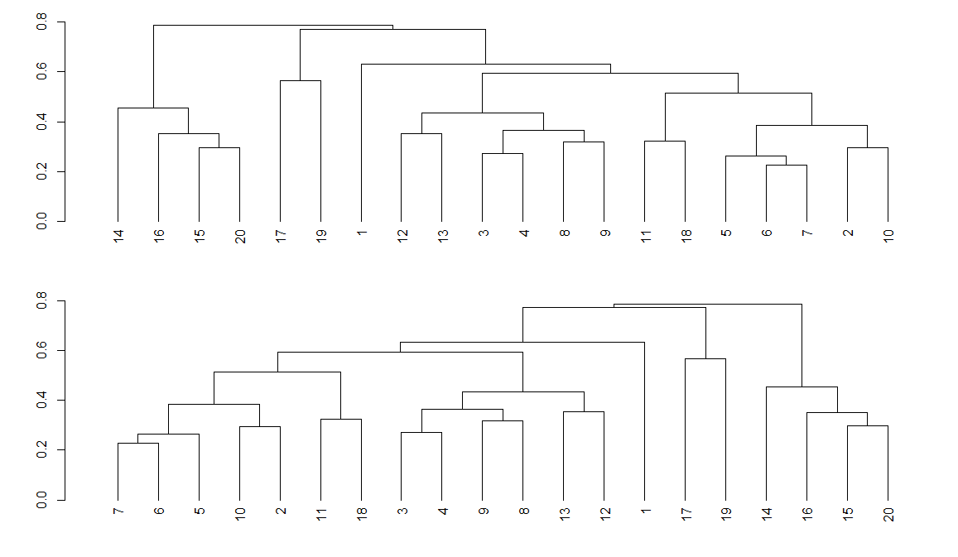
H-Cluster Reordering
den <- as.dendrogram(caver)
x <- scores(ord, display = "sites", choices = 1)
oden <- reorder(den, x)
plot(den)
plot(oden)

Slide 13
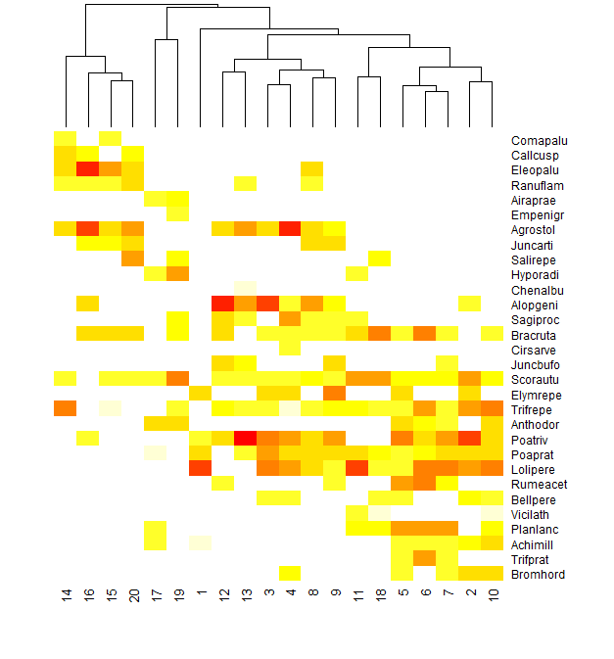
Tabasco Heat Maps
tabasco produces a similar table as vegemite using heatmap, where abundances are coded by colors.
The function scales the abundances to equal intervals for color palette, but either rows or columns can be scaled to equal maxima
tabasco(dune, caver, Rowv = FALSE)
tabasco(dune, oden, Rowv = FALSE)

Slide 14
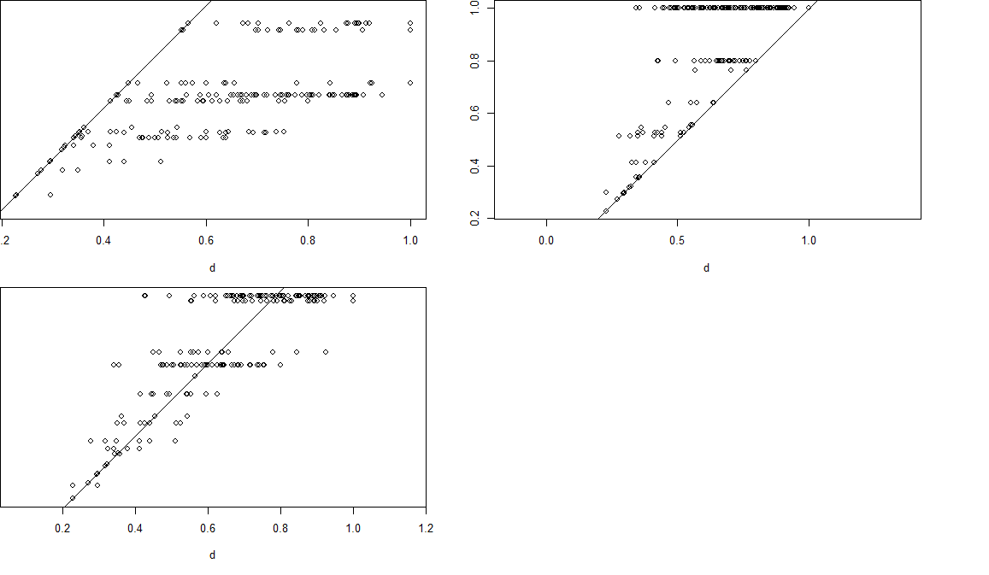
Cophenetic Distances for a Hierarchical Clustering
The cophenetic distance between two observations that have been clustered is defined to be the intergroup dissimilarity at which the two observations are first combined into a single cluster.
> plot(d, cophenetic(csin), asp=1)
> abline(0, 1)
> plot(d, cophenetic(ccom), asp=1)
> abline(0, 1)
> plot(d, cophenetic(caver), asp=1)
> abline(0, 1)

Slide 15
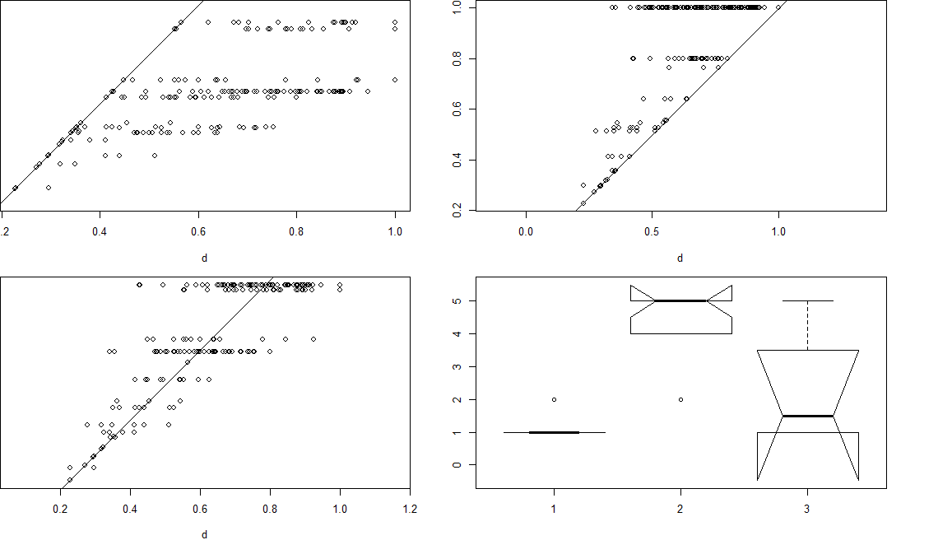
Redundancy Analysis
Function rda performs redundancy analysis, or optionally principal components analysis.
> anova(rda(Moist ~ cl))
Permutation test for rda under reduced model
Permutation: free
Number of permutations: 999
Model: rda(formula = Moist ~ cl)
Df Variance F Pr(>F)
Model 2 1.9272 12.359 0.003 **
Residual 17 1.3254
---
Signif. codes: 0 ‘***’ 0.001 ‘**’ 0.01 ‘*’ 0.05 ‘.’ 0.1 ‘ ’ 1
Data is the moisture values for the Dune data

Slide 16
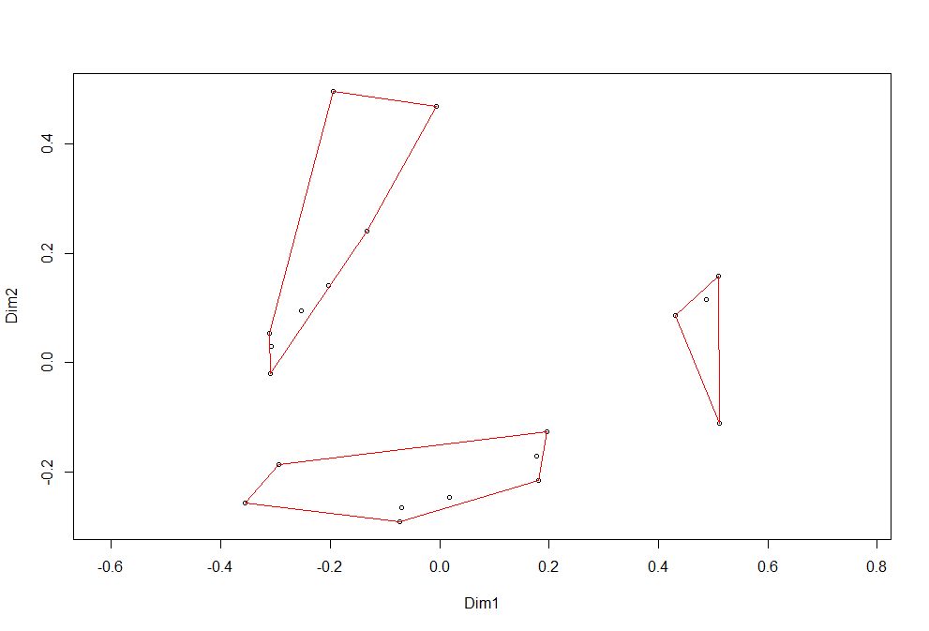
K-means clustering with Vegan
library(labdsv)
const(dune, cl)
importance(dune, cl)
mod <- indval(dune, as.numeric(cl))
names(mod)
summary(mod)
summary(mod, type = "long")
ckm <- kmeans(decostand(dune, "hell"), 3)
ckm$cluster
ordiplot(ord, dis="si")
ordihull(ord, ckm$cluster, col="red")

Slide 17
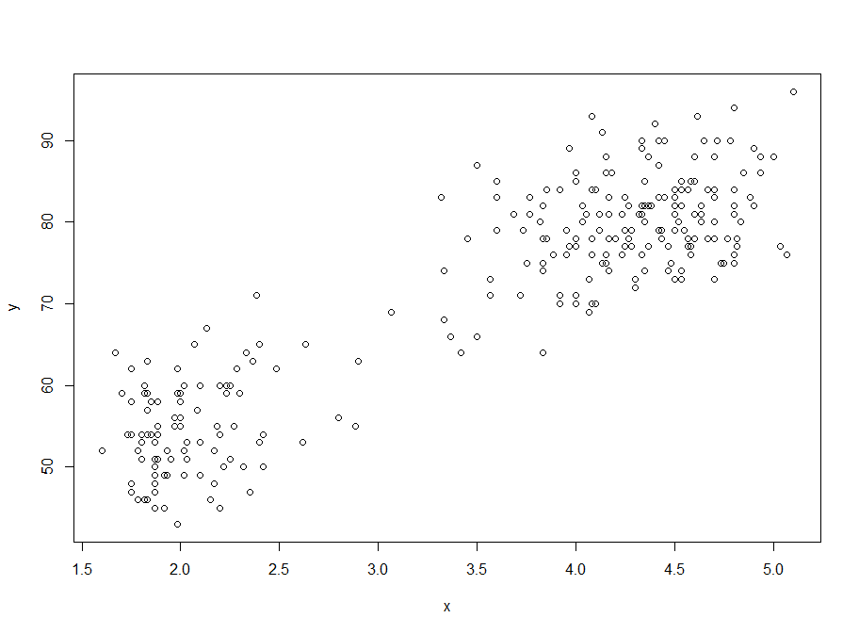
Cluster Estimation
# load mclust library
library(mclust)
# get the first column of the faithful data set
x = faithful[,1]
# get the second column of the faithful data set
y = faithful[,2]
# plot the spread points before the clustering
plot(x,y)
# estimate the number of cluster (BIC), initialize (HC) and clusterize (EM)
model <- Mclust(faithful)
# get the data set
data = faithful
# plot the clustering results
plot(model, faithful)
2d density estimate of Old Faithful data

Slide 18
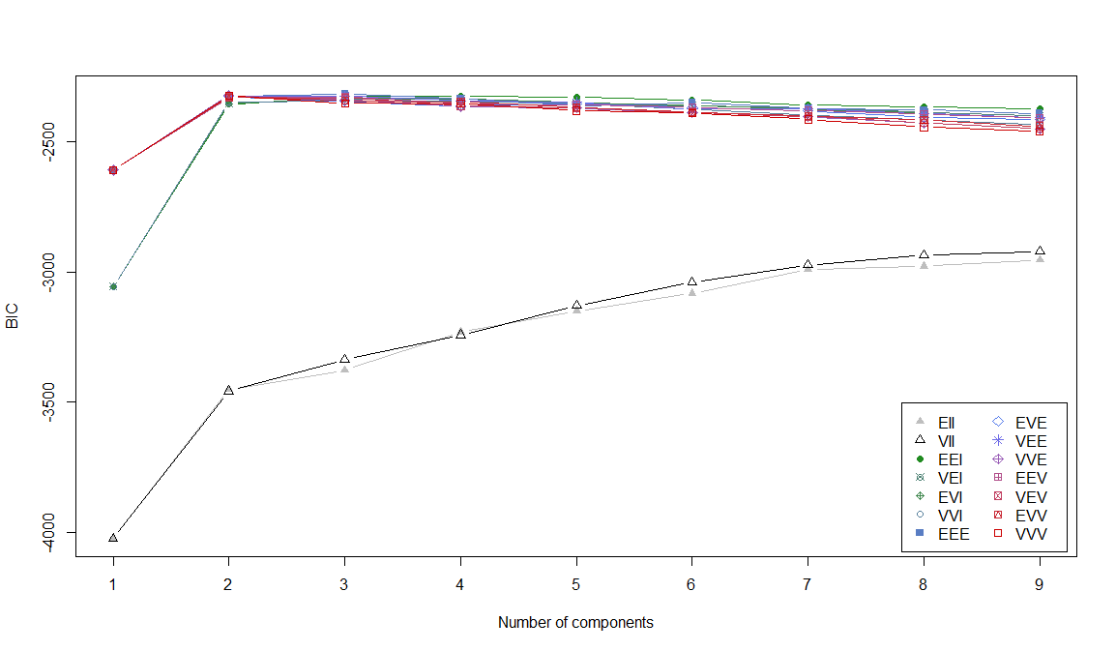
Bayesian Information Criterion (BIC) Plot

Slide 19
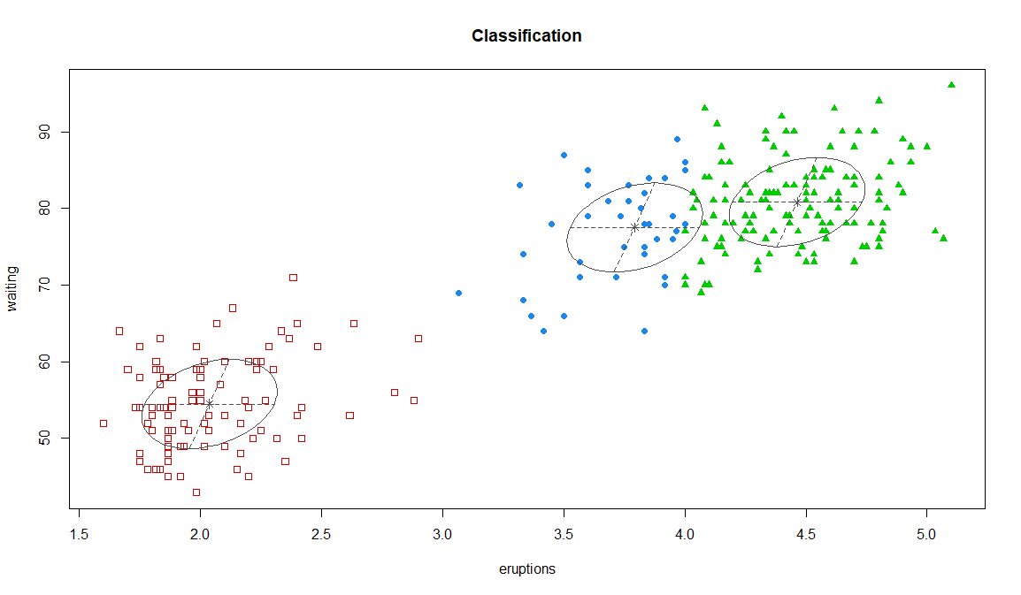
Classification Plot

Slide 20
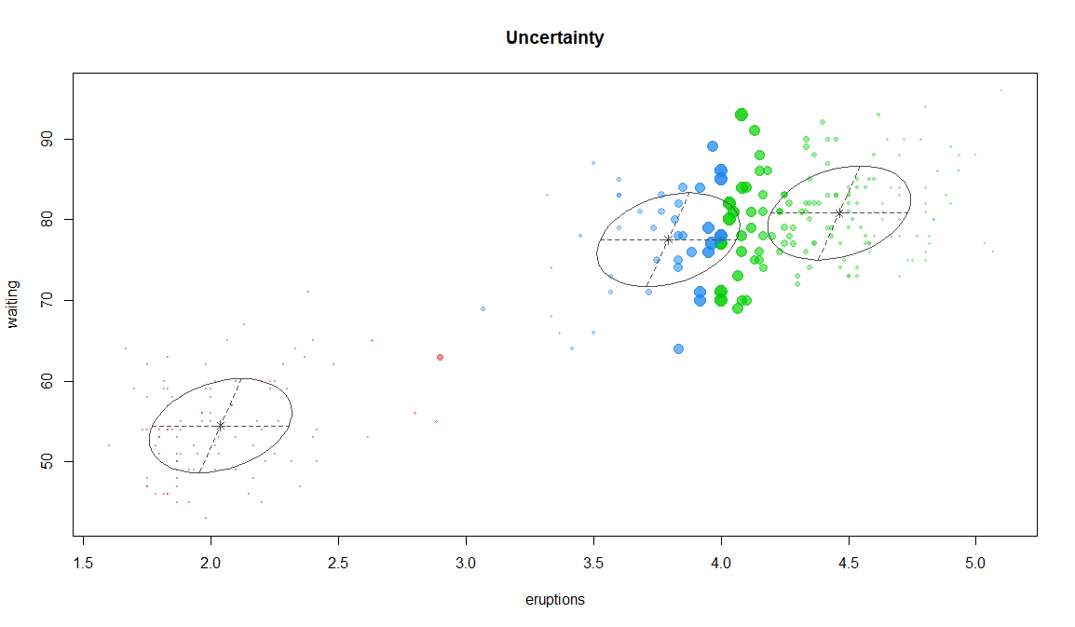
Uncertainty Plot

Slide 21
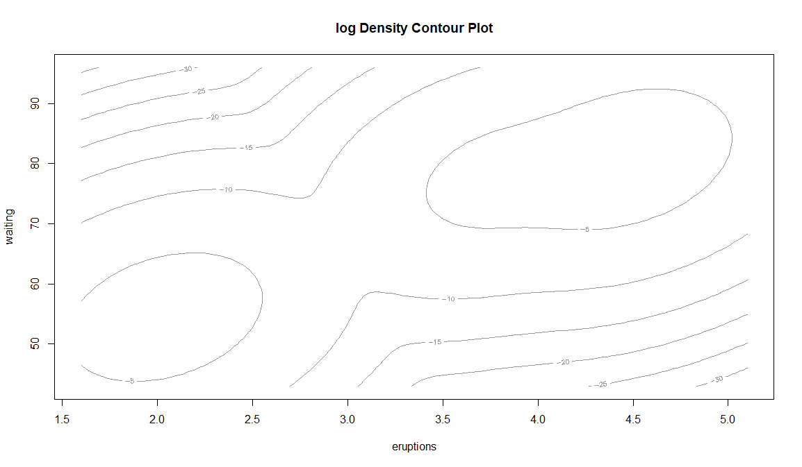
Density Plot

Slide 22
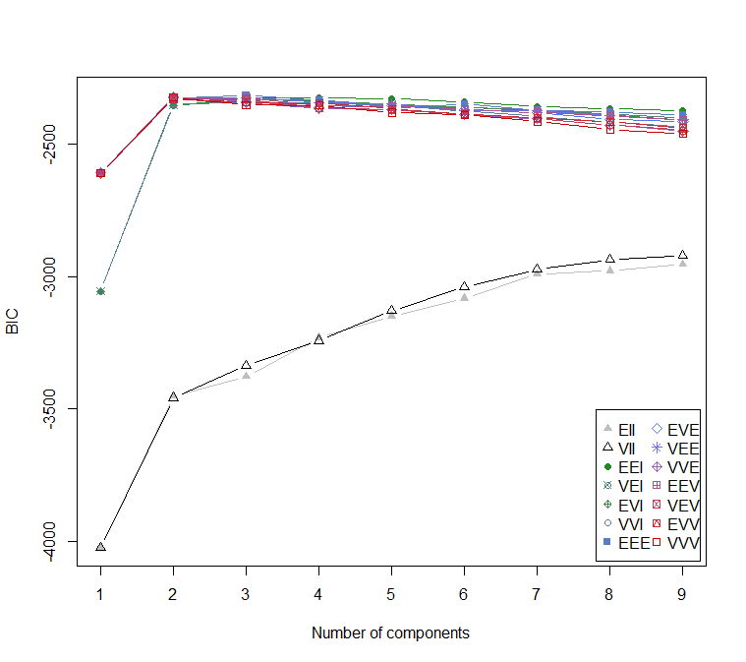
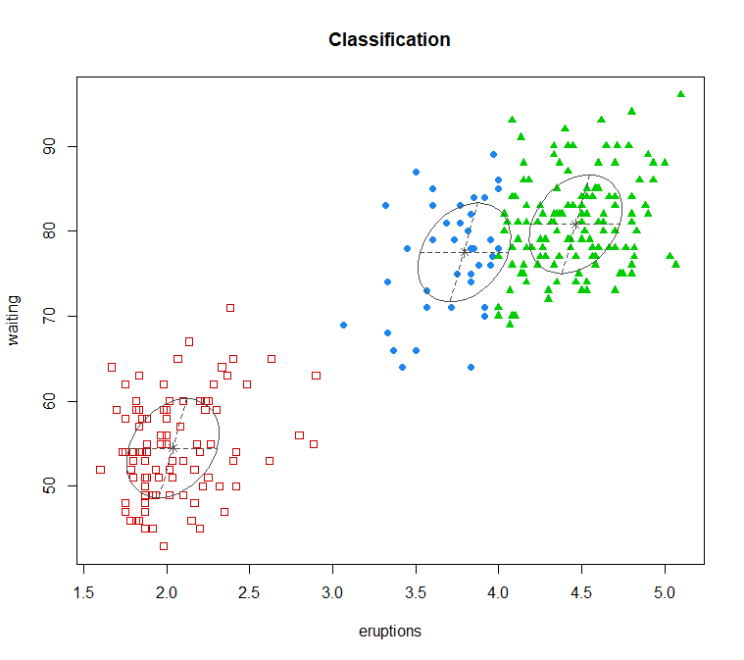
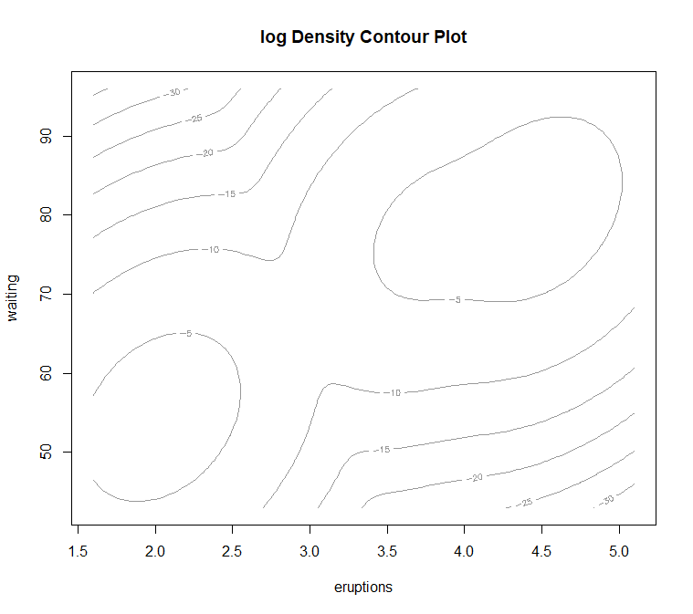
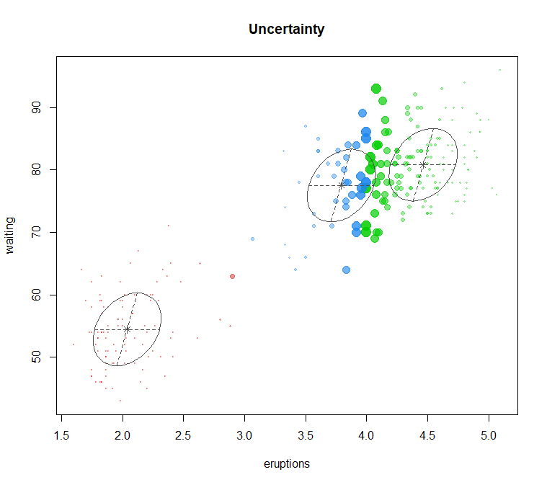
How many clusters are in the Old Faithful data?
2 clusters
3 clusters
2 clusters
2 clusters

Slide 23
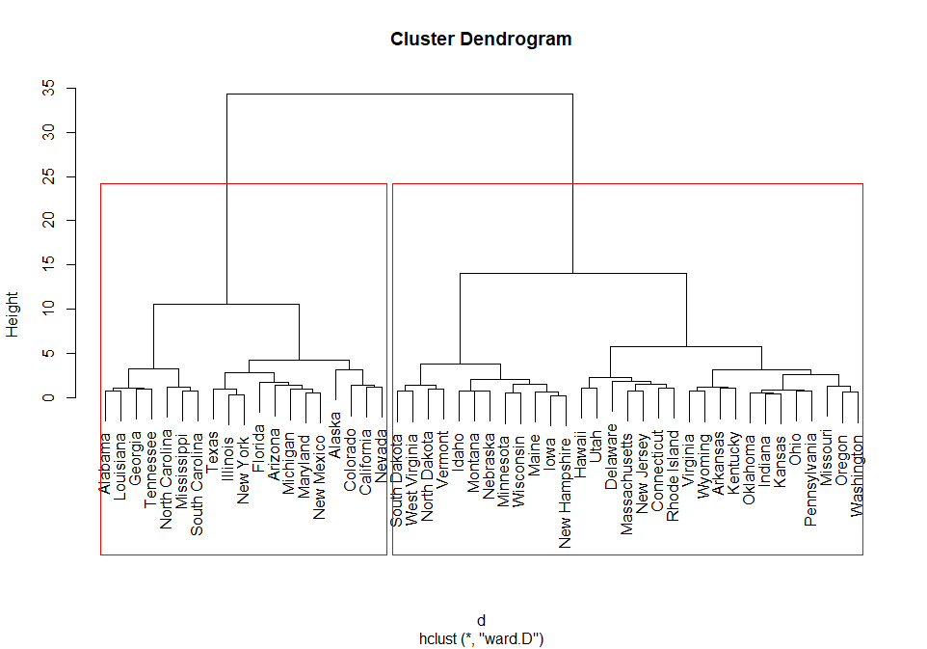
Crime Analysis
USArrests
A data frame with 50 observations on 4 variables.
[,1] Murder numeric Murder arrests (per 100,000)
[,2] Assault numeric Assault arrests (per 100,000)
[,3] UrbanPop = numeric Percent urban population
[,4] Rape numeric Rape arrests (per 100,000)

Slide 24
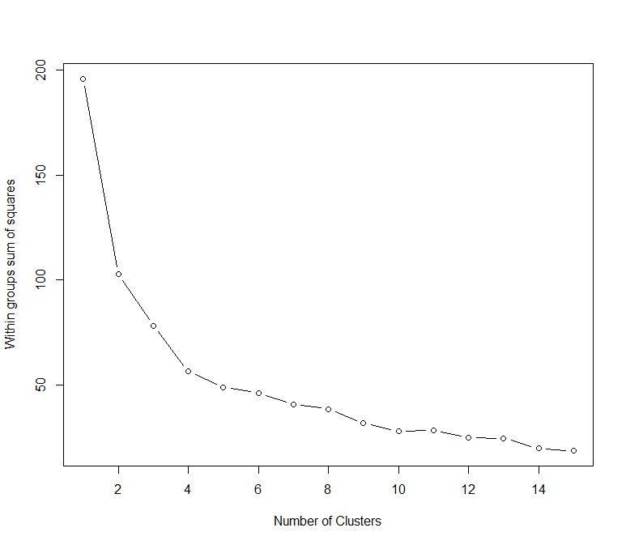
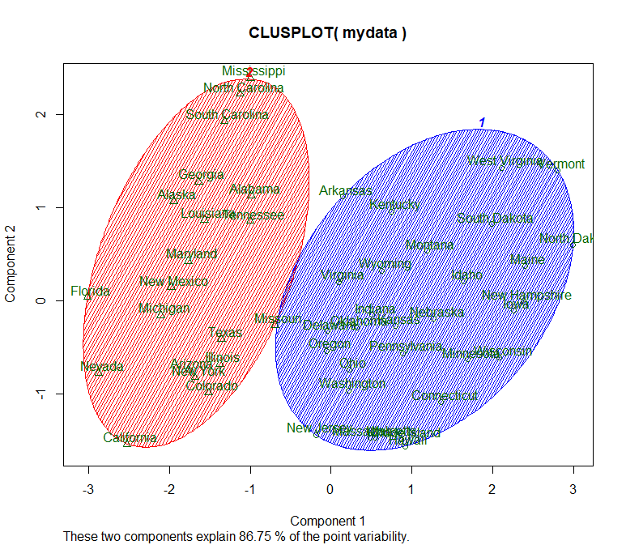
Number of Clusters
2 or 3 clusters

Slide 25
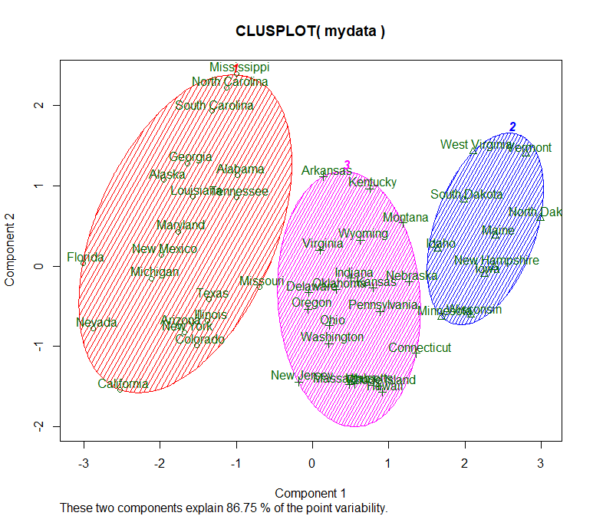
Cluster Means
> library(cluster)
> clusplot(mydata, fit1, color=TRUE, shade=TRUE, labels=2, lines=0)
> # get cluster means
> cmeans=aggregate(mydata.orig,by=list(classif), FUN=mean); cmeans
Group.1 Murder Assault UrbanPop Rape
1 1 12.165 255.25 68.40 29.165
2 2 2.680 70.10 51.00 10.910
3 3 5.965 136.60 69.95 18.460

Slide 26
Example: Merged Tables – Offers & Transactions
Offers
OfferID (N = 1…32)
Campaign (month)
Varietal (brand/manufacturer)
MinimumQty (kg)
Discount (%)
Origin (country)
PastPeak (TRUE/FALSE)
Transactions
CustomerLastName (Indian Surnames)
OfferID (N = 1…32)

Slide 27
Data Frame Manipulation - Reshaping
Library(reshape2)
#transactions is long-data
pivot<-melt(transactions[1:2])
#offers is wide-data
pivot<-(cast(pivot,value~CustomerLastName,fill=0,fun.aggregate=function(x) length(x)))
pivot<-cbind(offers,pivot[-1])
Wide data has a column for each variable
Long-format data has a column for possible variable types and a column for the values of those variables
You need wide-format data for some types of data analysis and long-format data for others
reshape2 is based around two key functions: melt and cast:
Melt takes wide-format data and melts it into long-format data.
Cast takes long-format data and casts it into wide-format data.

Slide 28
Data Frame Manipulaton – Pivot Table
cluster.data < -pivot[,3:length(pivot)]
Hedings of tthe cluster.data are headings from transaction data plus each surname (filled with group number)
A pivot table is a program tool that allows you to reorganize and summarize selected columns and rows of data in a spreadsheet or database table to obtain a desired report.
Varietal MinimumQty Discount Origin PastPeak Adams Allen Anderson
1 Malbec 72 56 France FALSE 1 0 0
2 Pinot Noir 72 17 France FALSE 0 0 0
3 Espumante 144 32 Oregon TRUE 0 0 1
4 Champagne 72 48 France TRUE 0 1 0
5 Cabernet Sauvignon 144 44 New Zealand TRUE 0 0 0
6 Prosecco 144 86 Chile FALSE 0 0 0

Slide 29
Fit the Data - Clustering
library(cluster)
fit<-KMeans_rcpp(cluster.data, clusters = 5, num_init = 5, max_iters = 100, initializer = 'kmeans++', verbose = F)
D=daisy(cluster.data, metric='gower')
Fit using K-means with 'Rcpp' Integration for the 'Armadillo' Templated Linear Algebra Library
We need to calculate how far away each customer is from the cluster’s mean.
We could use many distances indices, one of which is the Gower dissimilarity.

Slide 30
Fit the Dissimilarity Data – H-cluster
H.fit <- hclust(D, method="ward.D2")
groups <- cutree(H.fit, k=6)
plot(H.fit) # display dendrogram
groups <- cutree(H.fit, k=6)
rect.hclust(H.fit, k=6, border="red")
clusplot(cluster.data, groups, color=TRUE, shade=TRUE,
labels=2, lines=0, main= 'Customer segments')
H-cluster model
Determine the groups for clustering
Plot the tree
Prune tree into 6clusters
Draw dendogram with red borders around the 6 clusters
2D representation of the segmentation

Slide 31
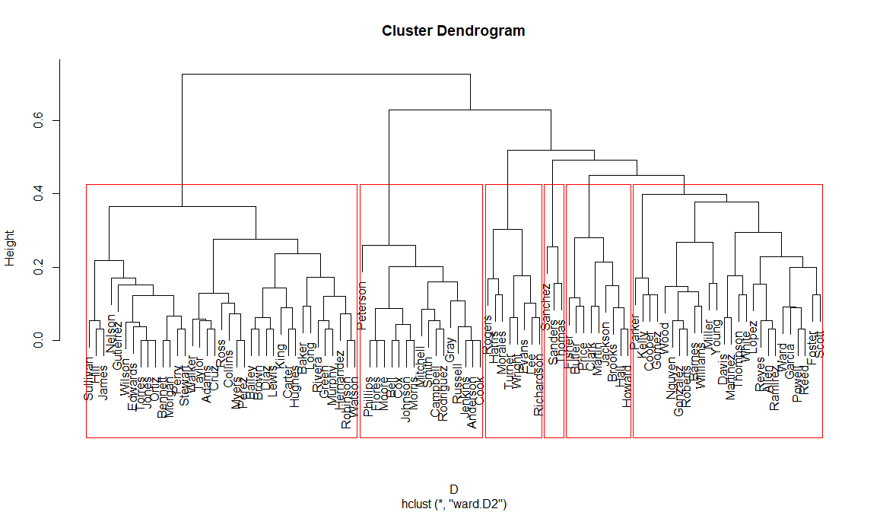
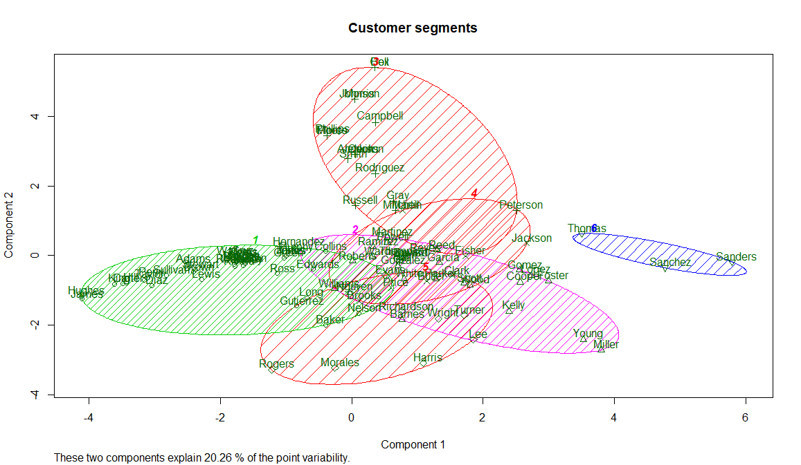
Plots

Slide 32
Merge Transactions and Offers
 | Name | Offer | Cluster
1 | Adams | 18 | 1
2 | Adams | 29 | 1
3 | Adams | 30 | 1
4 | Allen | 9 | 2
5 | Allen | 27 | 2
6 | Anderson | 24 | 3
cluster.deals<-merge(transactions[1:2], groups, by.x = "CustomerLastName", by.y = "row.names")
colnames(cluster.deals)<-c("Name","Offer","Cluster")
head(cluster.deals)
View(cluster.deals)

Slide 33
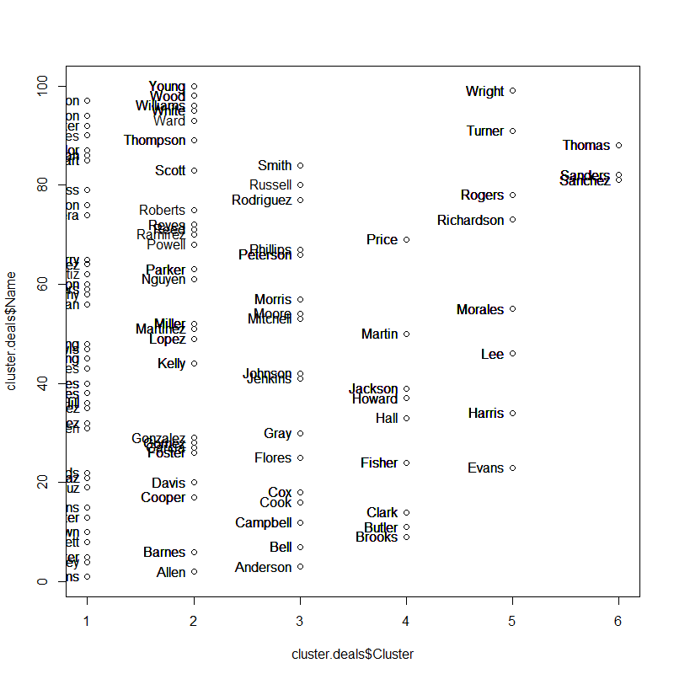
Reshape the Clustered Data
cluster.pivot<-melt(cluster.deals,id=c("Offer","Cluster"))
cluster.pivot<-cast(cluster.pivot,Offer~Cluster,fun.aggregate=length)
cluster.topDeals<-cbind(offers,cluster.pivot[-1])
plot(cluster.deals$Cluster,cluster.deals$Name,)
with(cluster.deals, text(Name~Cluster, labels = Name, pos = 2))

Slide 34
www.humalytica.com
http://www.amazon.com/Jeffrey-Strickland/e/B00IQ69QZK/
http://www.lulu.com/spotlight/strickland_jeffrey

